Slide 1


Copyright for Researchers
A presentation by
Berenice Scott.
15 September 2010

Slide 2
Overview
Researchers use copyright material
Researchers create copyright material
But first .... Some basics of copyright

Slide 3
What is Copyright?
Copyright is automatic protection of your creative work.
It is a balance between rights of creators as copyright owners, and the public as copyright users.
Is intended to encourage creativity and allow creators to profit from their work.
Notes:
There is no need to register for copyright protection.
A creator can be an author, illustrator, musician, photographer, draftsman etc.

Slide 4
What Does Copyright Protect?
Works
  Literary Works
  Dramatic Works
  Musical Works (published - for sound recordings, see below)
  Artistic Works
Subject Matter other than Works
  Cinematograph films
  Sound Recordings
  Broadcasts
  Published Editions of Works
Notes:
Literary Works: books, poems, articles, research papers, short stories, games’ rules, letters, email, instruction manuals, computer programs, song lyrics, catalogues, compilations, tables, questionnaires, dictionaries and other forms of writing
Dramatic Works: plays, film scripts, scenarios, librettos, mimes, other scenic or dramatic compositions intended to be performed, such as choreographic works
Musical Works: popular and classical scores and other combinations of melody and/or harmony in print or other form (but not sound recordings)
Artistic Works: paintings, engravings, photos, sculptures, maps, sketches, plans, drawings, technical and architectural drawings, prints, jewellery, dress patterns, computer graphics, buildings and models of buildings, craftworks such as ceramics, carvings and installations

Slide 5
Exclusive Rights of Copyright Owners
Things that only the copyright owner can do, or can license other people to do.
  reproduction in a material form
  publication
  performance in public
  adaptation or translation
  communication to the public
Notes:
These are the rights that the Copyright Act automatically grants to creators with copyright.
The Copyright Act also provides for the public to make use of copyright without having to seek permission from the copyright owner.

Slide 6
How long does copyright last?
In General
Life plus 70
  Life of creator plus 70 years as a general rule - for works
OR
Publication year plus 70
  70 years from the end of the year in which first published – for films and sound recordings
See ‘Duration of Copyright’
– UNE Copyright Guide. http://www.une.edu.au/copyright/introduction.php
Notes:
The duration of copyright has several variables, depending on the nature of the creative work. For example duration of a copyright in a book is determined from the death of its author, the duration of copyright in a film is determined by the ‘first published’ date.
The US Australia Free Trade agreement extended copyright from 50 years to 70 years but it did not reinstate copyright that had expired.
Once copyright has expired in a work you can use it any way you want to. If an out of copyright work is published (eg Shakespeare) a new copyright in the typesetting and layout of the work will last 25 years, but the work itself remains out of copyright.
Copyright will apply to any new work created from an out of copyright work. For example a film inspired by a Shakespeare play.
Some works will have many copyrights. For example, a song may have: the lyrics, translation of the lyrics, the musical arrangement, the recording.

Slide 7
Researchers as users of copyright material

Slide 8
How Researchers use others’ ©
Copy articles to keep for reference
Collect resources in the research phase of the thesis
Reproduce in thesis as a part of the final presentation
Include in journal articles and other publications
Notes:
Here are some ways that you may want to use copyright that does not belong to you. It’s always important to clearly distinguish between your own work and that of others. Keep a good bibliography.

Slide 9
Rights of Users – Fair Dealing
You may make a fair dealing with a work or an audiovisual item for the following purposes:
research or study (s40,s103C);
criticism or review (s41,s103A);
parody or satire (s41A,s103AA);
reporting news (s42,103B);
professional legal advice (s43,s104).
Notes:
These are ways that the Copyright Act permits you to use copyright without needing to ask permission from the copyright owner.
Note that there are generally restrictions or conditions attached to each use.
For example if you are relying on criticism or review, then the copying must be a valid use for the purpose of reviewing or criticising the work, not simply as an excuse to reproduce another’s work.
(Note, Lisa, research or study – the most common - is covered in the next slide.)

Slide 10
Fair dealing for research or study copying limits
10% or one chapter of a book, whichever is the greater;
One article from any one issue of a journal; or
More than one article if they are needed for the same research or course of study.
NOTE: 10% rule applies to literary, dramatic and musical works only – not artistic, not audiovisual.
Notes:
Most commonly, text based material is copied and relied on for theses, so the 10%, 1 chapter ‘rule’ is most relevant.
Artistic works, such as a photographs, can generally be copied and used in full for research and study purposes.
The amount that may be copied from audiovisual materials is determined by a number of checks of ‘reasonableness’ and the Purpose and character of your use.
These limits traditionally apply to print materials, but also to freely available materials on the internet. (Remember the internet is subject to Copyright Law too – rather like books and resources in a Library.)
Importantly no matter what format the material that you are copying for study purposes, if you do not own the copyright, you should never copy more than you need.

Slide 11
Licensed material
Contract, or Licence terms apply, not the Copyright Act
Includes ProQuest, Informit and Expanded Academic ASAP
UNE staff and students - can generally copy what they require for their personal and study use, under licence conditions, but may need permission to reproduce works in their thesis.
Notes:
Note that if you are required to enter a password, or click ‘I Agree’ to something on the internet, you are entering into a contract.
This covers full text library database.
Articles sourced from Library databases can be copied for research purposes, but will generally require copyright owners permission before they are reproduced – either in full or in part – in a thesis or journal article.

Slide 12
Researchers as creators of copyright material

Slide 13
Who owns copyright?
Copyright is automatic once your work is in a material form – no need to register
Copyright is generally owned by the creator (author, photographer etc), but a contract can vary this:
  Employers sometimes claim copyright
  a scholarship or funding agreement may have a copyright clause
Joint authorship – ownership divided equally, or by agreement

Slide 14
UNE IP Policy
UNE does not usually claim copyright ownership in research publications but….
See case studies in the Knowledge Assets and Intellectual Property Policy: http://www.une.edu.au/policies/pdf/knowledgeassets&intellectualproperty.pdf
Notes:
Students generally own their own copyright - however, it may be that your supervisor or others have contributed ideas or have collaborated with you. It is important to keep a record of this.
The UNE IP Policy contains some useful case studies that are worth reading and which highlight particular situations.

Slide 15
Dealing with the finished product
Notes:
You’ve finished your research.
You’ve written it up.
You’re ready to make your mark!

Slide 16
Your thesis may include…..
Your own work
Others’ work
  Quotes
  Diagrams
  Images
  Tv

Slide 17
The old fashioned way
Submitting three copies to examiners:
  You will own copyright in the work you create
  Third party copyright can be included under the Fair Dealing Provisions
  It’s possible that only your examiners and your parents will ever see the finished product!
Notes:
One copy on the library shelves would be available for on-campus access. In rare instances a thesis might be requested from another student for their study purposes.

Slide 18
Here and now
Theses are submitted electronically for marking
Research theses are retained in e-publications@UNE
This is an open access repository of University publications available worldwide on the internet

Slide 19
e-publications@UNE
  Can raise the profile of your research
  May be considered publishing
  You own copyright in the work you create, so you can authorise this publication (or choose not to)
  BUT
  Publications require permission from the owners of third party copyright material if you have used any
Notes:
NOTE: e-publications@UNE needs your permission to include your work. Remember as copyright owner, one of your rights is to publish, but it may be that you want to protect your work in order to release it at a later date as a commercial book. You will be given the option to include only the bib details and abstract in e-publications@UNE if you have good reason to withhold full text.

Slide 20
Why access matters
Maximum access = maximum chance of being cited
You could be cited up to 50% times more than if you are only published in print journals

Slide 21
When you publish your research paper or put it online…
You are no longer covered by ‘fair dealing for research and study’ exceptions
Permission is needed from the copyright owner to reproduce more than an ‘insubstantial part’ of a copyright work
You need to get the permissions yourself
Notes:
Some theses are by publication. Like e-publications@UNE, publishing in a journal generally requires permission if you want to include third party copyright.
Sometimes small quotes can be included without seeking permission, or research and criticism exception can be relied upon, but many publishers are cautious and require permission even for this use.

Slide 22
Digital Theses
When you submit your thesis to e-publications@UNE, you will be asked if the thesis contains any copyrighted material belonging to others.
If the answer is ‘yes’:
  You must supply proof of permissions or
  It may be necessary to hide all or some content online (it can remain in the hard copy version)
Notes:
Remember, you do not have to submit your work to e-publications@UNE. You may have good reason to keep it confidential.

Slide 23
If you use third party Copyright
Get permission to use it before you include it in your thesis
Ensure the permission includes deposit in your institutional repository
If it is needed for a published chapter/ article then get this permission too
Keep the permission on file.
Note: Quotations are generally considered insubstantial portions. However, you must acknowledge the source. Be aware that some publishers may still require permission.

Slide 24
Managing your copyright
Submitting journal articles for publication:
Journal publishers generally ask authors to transfer copyright
If this transfer is unconditional,
  The author will be giving away their own rights to reproduce the work
  Access may be restricted to those people with subscription access to the journal

Slide 25
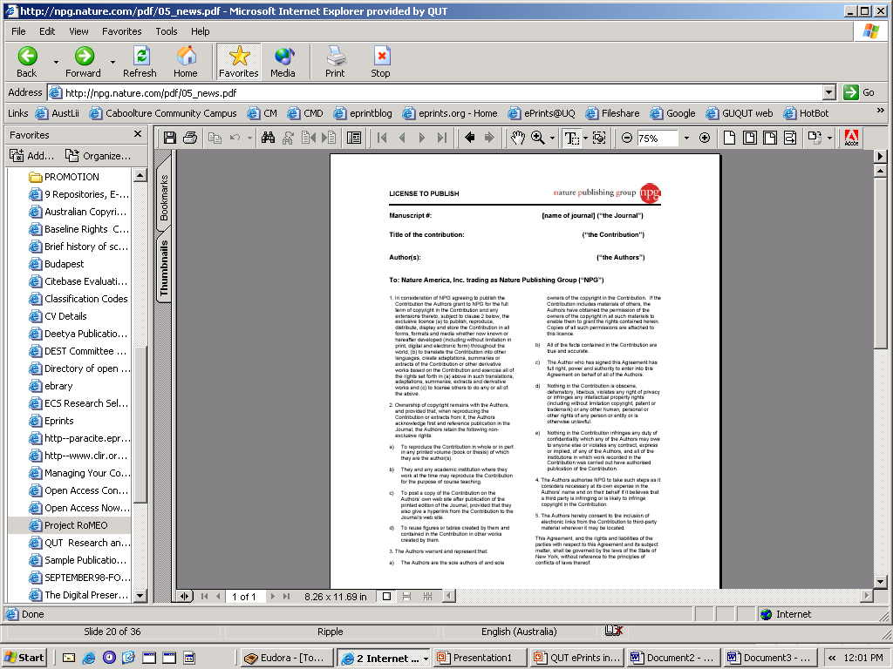
Retain some rights
Before submitting your article, check the publisher’s policy
  http://www.sherpa.ac.uk/romeo.php
Check the publication agreement
..the author retains the following non-exclusive rights…..
c) To post a copy of the Contribution on the Authors’ own web site after publication of the printed edition of the Journal, provided that they also give a hyperlink from the Contribution to the
Journal’s web site.
Notes:
You should seek independent advice before signing a publishers agreement. You may be giving away rights that you do not want to.

Slide 26
Options for retaining rights
  Modify the publication agreement:
    State that you are retaining the right include work in your institutional repository
    Attach an addendum which modifies the terms of the agreement on your terms
  Retain the copyright and give the publisher a ‘licence to publish’

Slide 27
Further information
UNE Copyright Guide http://www.une.edu.au/copyright/
Copyright guidelines for HDR candidates http://www.une.edu.au/copyright/thesis-resource.php
UNE e-repository website http://e-publications.une.edu.au/vital/access/manager/Index
Australian Copyright Council website http://www.copyright.org.au/
UNE Copyright Officer copyright@une.edu.au

